Slide 1

Learning Objective
I will compare parallel boxplots
Enter quietly, please be ready with the following on your desk:
Whiteboard
Whiteboard marker
Exercise Book
Pencil, pen, ruler and red pen
Diary
Calculator
Device – charged or borrowed from Library before maths

Slide 2
Daily Review
To find the median of a data set:
Step 1: Order the numbers from smallest to largest. Step 2: Find the middle number.
Find the minimum, maximum, median, lower quartile and upper quartile of the following data set:
2, 9, 4, 2, 5, 8, 9, 6, 6, 2, 3, 7, 5
2, 2, 2, 3, 4, 5, 5, 6, 6, 7, 8, 9, 9
To find the lower quartile of a data set:
Step 1: Underline the bottom half of the data set. Step 2: Find the middle number.
To find the upper quartile of a data set:
Step 1: Underline the top half of the data set. Step 2: Find the middle number.
Minimum = 2
If the median is one of the values, don’t include it in the lower/upper half.
If the median is between two values, include it in the lower/upper half.
Maximum = 9
Median = 5
Lower quartile = 2.5
Upper quartile = 7.5

Slide 3
Daily Review
A Mathematics teacher creates a 5 number summary of their students’ test results.
Use this data to draw a boxplot.
Minimum | 10
Q1 | 35
Median | 55
Q3 | 70
Maximum | 100
Whisker
Box
Whisker

Slide 4
Daily Review
A Science student records the temperature at midday every day for a month.
Draw a boxplot of their data.
Minimum | 13
Q1 | 15
Median | 16
Q3 | 18.5
Maximum | 24

Slide 5
Learning Objective
CFU 1
What will we learn?
I will compare parallel boxplots.
CFU 2
What will we learn?
CFU 3
How will we know if we’ve been successful?
Success Criteria
CFU 4
How will we know if we’ve been successful?
I will be able to:
Find the 5 number summary of parallel boxplots.
Compare the median, range and inter-quartile range of parallel boxplots.

Slide 6
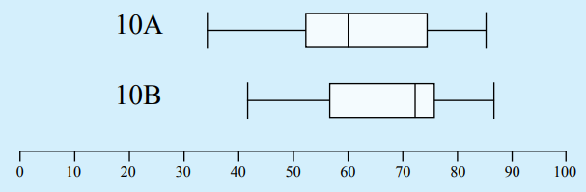
Concept Development
CFU 1
Why is a parallel boxplot useful?
Boxplots are useful when comparing data sets. You can use a parallel boxplot, which is when two or more boxplots are drawn on the same number line.
From the parallel boxplot, you can easily compare and comment on the median, range and inter-quartile range of the data sets, as well as deciding which data set is more consistent.
Two classes take a test and their teacher wants to compare the results. They find the 5 number summary and draw two boxplots on the same number line.
10B has a higher median score than 10A, and also has a smaller range and inter-quartile range.
10B performed better and more consistently in the test.

Slide 7
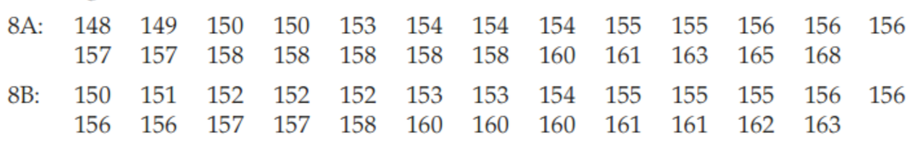
Skill Development
CFU 1
What three things do you need to compare in a boxplot?
The heights (cm) of the students in two Year 8 classes were recorded.
Find the 5 number summary of each class’ data.
Find the range and inter-quartile range of each class’ data.
8A
8B
8A
Minimum | 148
Q1 | 154
Median | 156
Q3 | 158
Maximum | 168
Minimum | 150
Q1 | 153
Median | 156
Q3 | 160
Maximum | 163
Range: 168 – 148 = 20
IQ range: 158 – 154 = 4
8B
Range: 163 – 150 = 13
IQ range: 160 – 153 = 7

Slide 8
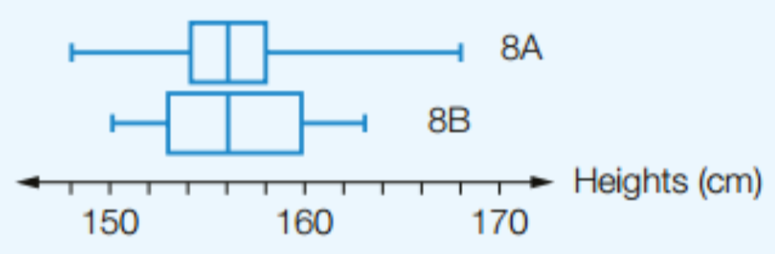
Skill Development
CFU 1
What three things do you need to compare in a boxplot?
8A
8B
8A
Minimum | 148
Q1 | 154
Median | 156
Q3 | 158
Maximum | 168
Minimum | 150
Q1 | 153
Median | 156
Q3 | 160
Maximum | 163
Range: 168 – 148 = 20
IQ range: 158 – 154 = 4
8B
Range: 163 – 150 = 13
IQ range: 160 – 153 = 7
Draw a parallel boxplot of the two class’ data.
Compare the median, range and inter-quartile range for each class.
The medians for the two classes are the same. The range for 8A is much larger than for 8B. However, the IQR for 8A is much smaller than the IQR for 8B.

Slide 9
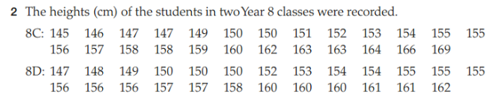
Guided Practice
Reminders:
Step 1: Find the 5 number summary, range and inter-quartile range of the data. Step 2: Draw a parallel boxplot of the data. Step 3: Compare the median, range and inter-quartile range.
8C
8D
8C
Minimum | 145
Q1 | 150
Median | 155
Q3 | 161
Maximum | 169
Minimum | 147
Q1 | 151
Median | 155
Q3 | 159
Maximum | 162
Range: 169 – 145 = 24
IQ range: 161 – 150 = 11
8D
Range: 162 – 147 = 15
IQ range: 159 – 151 = 8

Slide 10
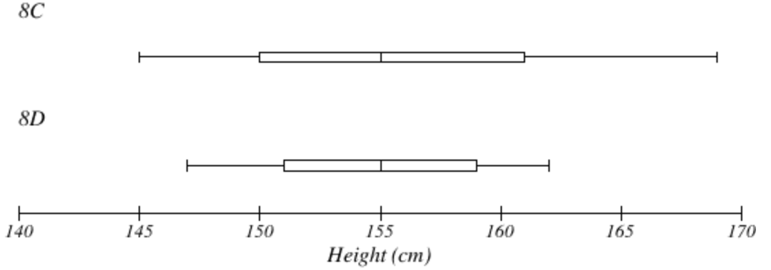
Guided Practice
Reminders:
Step 1: Find the 5 number summary, range and inter-quartile range of the data. Step 2: Draw a parallel boxplot of the data. Step 3: Compare the median, range and inter-quartile range.
8C
8D
Minimum | 145
Q1 | 150
Median | 155
Q3 | 161
Maximum | 169
Minimum | 147
Q1 | 151
Median | 155
Q3 | 159
Maximum | 162
8C
Range: 169 – 145 = 24
IQ range: 161 – 150 = 11
8D
Range: 162 – 147 = 15
IQ range: 159 – 151 = 8
The medians for the two classes are the same. The range for 8C is much larger than for 8D. The inter-quartile range for 8C is also larger than for 8D.

Slide 11
Guided Practice
To describe the Distribution of Data or Compare Data Sets:
Shape: State and compare the shape. Symmetrical? Negative or positive skew? Gaps? Clusters?
Location (centres): State and compare the mean, median or mode
Spread: State and compare the range and IQR

Slide 12
Describe the distribution of data:
Guided Practice
Two classes take a test and their teacher wants to compare the results. The two boxplots are shown on the same number line.
Shape: Class 10A is positively skewed and 10B is negatively skewed.
Location: The median for 10A is just under 60 whereas the median for 10B is higher at around 72.
Spread: Class 10A’s range and IQR are both higher than 10B at approximately 54 and 23 compared to approximately 46 and 20.

Slide 13
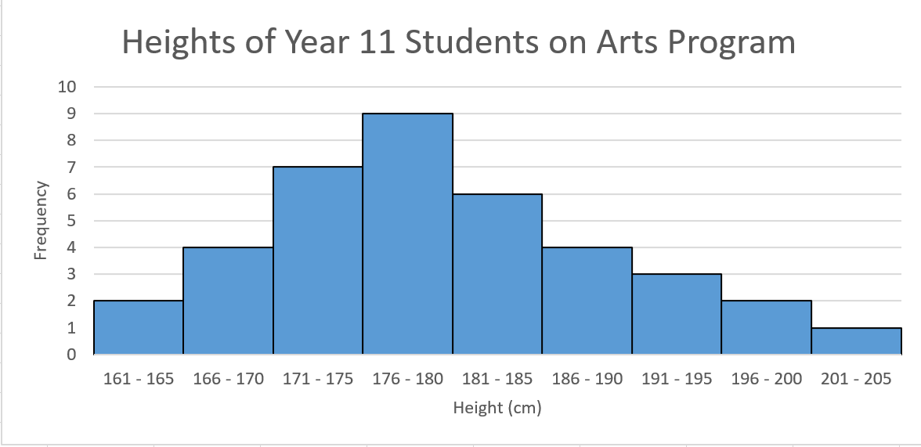
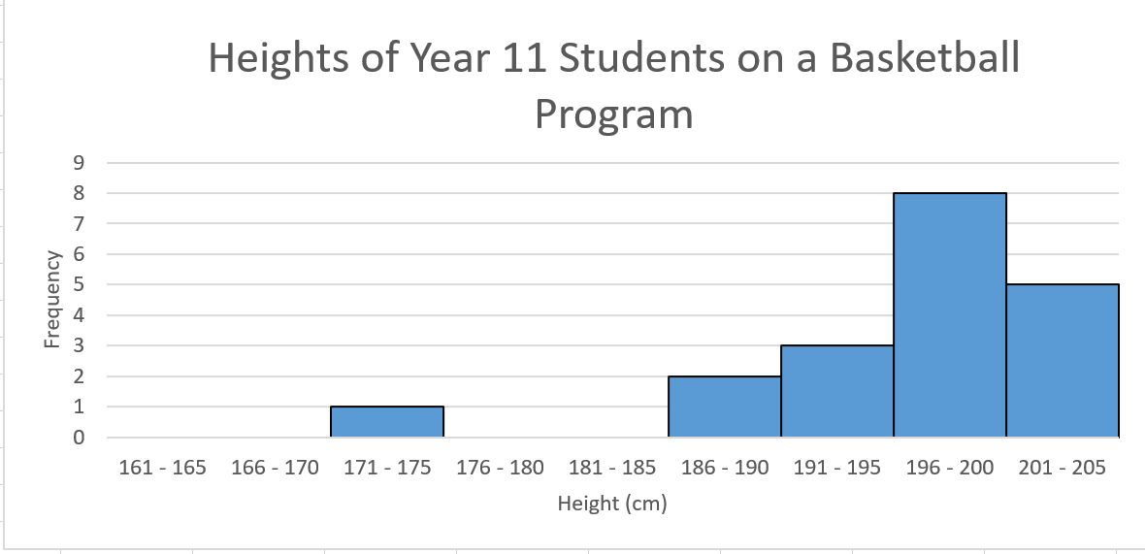
Describe the distribution of data:
Guided Practice
Shape: Arts Program students heights are almost symmetrical with a slight positive skew whereas the Basketball students heights are negatively skewed.
Location: The modal class interval for the Arts students is 176 – 180 cm whereas it is 196 – 200 cm for the Basketball students. The mean, median and modal intervals will be very similar for the Arts students. The mean will be higher than the median for the Basketball students.
Spread: The Arts students range and IQR are both higher than the Basketball students. The ranges being approximately 44 and 34 respectively.

Slide 14
Independent Practice
Mathspace – Year 10 Mainstream Compare Data Sets CLASSWORK

